Slide 1

Celebrating rest
Notes:
In 1996, 7-year-old Jessica DuBroff was attempting to be the youngest student pilot to fly across the United States. Accompanying her were her father and her flying instructor. The first couple of days went uneventfully, but as often happens, the media were closely following this attempt and hounded the instructor pilot for midnight and early morning interviews.
While talking with his wife on the phone from Wyoming, the instructor told her how frustrated he was with all the media interruptions, how fatigued he had become as a result of the lost sleep, and how much he was looking forward to being finished with the “media zoo.”
The next morning, while preparing for the flight, this instructor with an impeccable record for safety uncharacteristically failed to get a weather briefing before departure. As a result, he flew directly into a storm and the plane crashed shortly after takeoff. No one survived.
Interviews with ground staff later revealed that this very experienced pilot had started the engine without removing the wheel chocks—something every pilot does before cranking the engine. This forgetfulness evidenced his extreme state of fatigue.*

Slide 2

Fatigue: A health problem
Notes:
Sleep science tells us that as in the case of this experienced instructor, tired minds are much more likely to make serious mistakes. In most societies of the world today, a significant percentage of the population is sleep deprived. In the United States fatigue is one of the 10 most common reasons people visit a physician.

Slide 3

Tired people become inefficient
Notes:
The need to rest and relax appears to be the greatest when there seems to be no time for it. Without rest and relaxation all humans suffer cognitive impairments. Tired people become inefficient, slower, less safe, and make more mistakes. To remain “at the top of our game” we need adequate sleep every night. There have been many attempts to increase productivity by extending the workweek and daily working hours. They have all failed because we each have a physiological need for rest each day, as well as a day off each week and a restful annual vacation. For peak cognitive performance and abundant energy, we must celebrate the refreshing gift of sleep.

Slide 4

Involuntary sleep
Notes:
When our brains are tired enough we will go to sleep involuntarily. These short periods of rest are called micro-sleeps and generally last from a fraction of a second to no more than a second or two. If we are idly sitting in a chair, this usually causes no problem. Should we be operating a complex piece of machinery or carefully seeking to solve a multifaceted problem, however, these momentary lapses could result in catastrophic outcomes.

Slide 5

Sleep deprivation
Notes:
Many factors of our increasingly chaotic, 24/7 world of tempting and demanding activities contribute to the growing problem of sleep deprivation. The rising number of choices available to us, such as playing computer games or watching television in the evenings, often can delay the onset of sleep. Life has simply become more complex.
A growing body of evidence shows that sleep deprivation impairs our cognitive performance, which in turn influences the quality of our decisions, our emotional control, and our efficiency, productivity, and safety. We all need sufficient rest to restore the wear and tear of life.
Fascinating research has established that when we are tired the “executive functions” of our minds suffer. We become less effective at recognizing the choices that are available to us and less capable of deciding which of the choices is best. Even if we can clearly see the choices, we may not be able to act on what we know we should do. Our creativity is reduced, along with our efficiency.

Slide 6
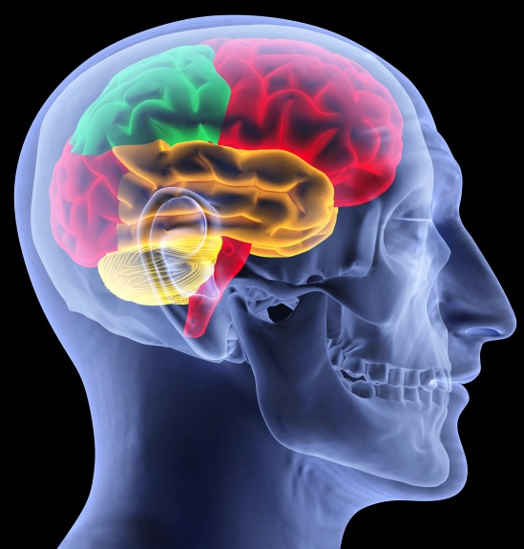
Decision making from the frontal lobe
Notes:
The frontal lobes of our brains are where we combine the current information from our senses with previously learned information and life experiences to make our decisions. It’s this portion of the brain that is most affected by insufficient sleep and rest. Fatigue lowers our cognitive efficiency, lessens the awareness of our surroundings, reduces the ability to process new information, decreases our long-term memory, and impairs the learning of new information. Because success in almost all of life’s endeavors is determined by the quality of the decisions we make, it is vitally important to rest as needed.
Sadly, today there is a ubiquitous intrusion of personal, social, and cultural activities into the time that traditionally has been reserved for sleep. Consequently, attention spans are diminished, judgment is impaired, and our ability to carry out complex mental operations is reduced.

Slide 7

Sleep debt
Notes:
When we miss out on sleep, we accumulate what is known as “sleep debt.” As this accumulates, we become less productive. Research was conducted with four groups of people who all had the same demonstrated skill level in performing identical tasks throughout 21 days of activity. Their productivity was significantly reduced as nightly sleep was shortened. After the full 21 days of measurements, the productivity of those who got 7 hours of sleep per night dipped about 8 percent. The group that got 6 hours of sleep, however, saw their productivity drop by 55 percent, while those getting 5 and 4 hours of sleep were able to produce only 35 percent and 20 percent respectively of what the 7-hour sleepers produced.

Slide 8

Sleep debt can alter metabolic state
Notes:
Sleep traditionally has been viewed for its effects on the function of the brain and emotions. Current research, however, is finding that even moderate sleep debt in healthy volunteers can alter their metabolic state in such a way that it mimics the glucose metabolism of diabetics. After four hours of sleep for six nights, healthy young men experienced a 30-percent decrease in their body’s ability to metabolize carbohydrates. They experienced significantly higher levels of the stress hormone cortisol, and a decrease in insulin sensitivity. This and other research suggests that there may be a link between the growing epidemic of sleep deprivation and the epidemic of obesity.

Slide 9
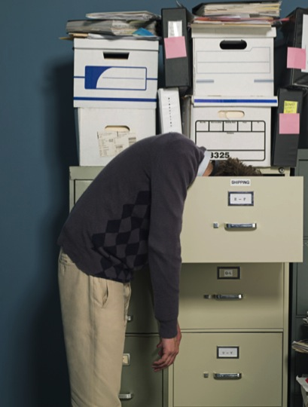
Sleep deprivation leads to decreased performance
Notes:
It’s interesting that sleep deprivation leads to decreased performance similar to that which occurs when a person is under the influence of alcohol. Studies have shown that 16 to 18 hours of wakefulness (one long day) in healthy adults results in impairments comparable to the legal blood-alcohol level of intoxication in the United States and many other countries of greater than 0.08 percent.

Slide 10

How much sleep do we need?
Notes:
Sleep needs vary between individuals. Nearly all sleep experts agree, however, that seven hours of sleep per night is enough to “get by on,” but that most people need about eight hours for optimal cognitive performance. Thomas Edison reportedly believed that sleep was a waste of time, and he set out to invent the electric light bulb in order to extend daylight hours. He reportedly slept four to five hours per night. Yet, those who worked with him in his laboratory reported that he frequently took naps during the day. Adequate nighttime sleep should remove most daytime sleepiness and provide a sense of calm well-being and alertness.

Slide 11

Students often study most of the night
Notes:
Students often will study most of the night when cramming for an examination, and they often suffer the consequences of sleep deprivation in poor grades as a result. The way people choose to live and order their lives, along with often hectic work schedules, frequently results in increased inattention at work. Sleep provides the “right stuff.” It prepares bodies and minds for peak performance.

Slide 12

Two major types of sleep:
Non-rapid eye movement sleep
Rapid eye movement sleep
Notes:
Sleep is divided into various stages. These are based on the characteristic waveforms seen on electroencephalographic recordings of brain-wave activity. There are two major types of sleep: nonrapid-eye-movement sleep and rapid-eye-movement sleep.
Non-rapid eye movement sleep is often characterized by four stages. The first two are deviations from wakefulness and generally last only a few minutes. Stages three and four are known collectively as “slow-wave sleep.” It is during this period of “deep sleep” that the restoration and growth of body tissue occur and immunity to infections is strengthened.

Slide 13

Rapid-eye-movement sleep
Notes:
Rapid-eye-movement sleep is characterized by a waveform similar to wakefulness. The eyes will move back and forth rapidly under closed lids as though looking from side to side, even though the person is sound asleep. Our dreams occur during this phase of sleep, although we usually recall very little of the dream content. Some individuals may sleepwalk, wet the bed, or grind their teeth during this phase. Rapid-eye-movement sleep is very important for mental and emotional restoration. Many important and fascinating functions take place here, including memory organization and reorganization, as well as the refreshing of memories.

Slide 14

Both types of sleep are necessary
Notes:
During a good night’s sleep, these two types of sleep occur in approximately 90-minute cycles that are repeated from four to six times during the night. Both types of sleep are necessary for complete physical and mental rest. The recuperative value of sleep can be measured by the shape of these cycles and is called the “sleep architecture.” Good sleep architecture results in recuperative sleep, which enhances learning and improves productivity.
Certain choices—such as irregular times for retiring and awaking, worry and anxiety, certain medications and alcohol, and eating just before going to bed—can impair good architecture.
Sadly, most sleep-deprived people are totally unaware of their own reduced capabilities because they have been sleepy for so long they don’t know what it’s like to feel wide awake. A rested person will accomplish more in less time and do it better, more effectively, and safely!

Slide 15

Steps to getting to sleep
Learn to value sleep
Establish a regular bedtime
Notes:
Steps to Getting to Sleep
Learn to value sleep. We never accomplish what we do not value.
Establish a regular bedtime ritual to let your mind and body know that you are preparing to sleep.

Slide 16

Exercise every day
Notes:
Exercise appropriately every day, at least four to five hours prior to retiring.

Slide 17

Establish regular time for rising and retiring
Use a comfortable bed in quiet bedroom
Notes:
Establish regular times for rising and retiring, and stick to them every day—even on weekends.
Use a comfortable, firm bed located in a quiet, cool bedroom not cluttered with TVs, computers, and exercise equipment.

Slide 18


Eat lightly in evening
Avoid exciting or depressing TV…soon before bedtime
Notes:
Eat lightly in the evening, several hours prior to bedtime.
Avoid watching exciting or depressing TV programs or movies, engaging in stressful events such as arguments, or making momentous decisions soon before bedtime.

Slide 19

See your personal physician if you suspect a sleep disorder
Notes:
See your personal physician if you suspect a sleep disorder or other medical condition.

Slide 20

Put your trust in God
Notes:
Put your trust in God. Give Him your problems and anxieties.
Remember: Tonight’s sleep builds tomorrow’s energy! Sleep is as important as diet and exercise, only easier!

Slide 21
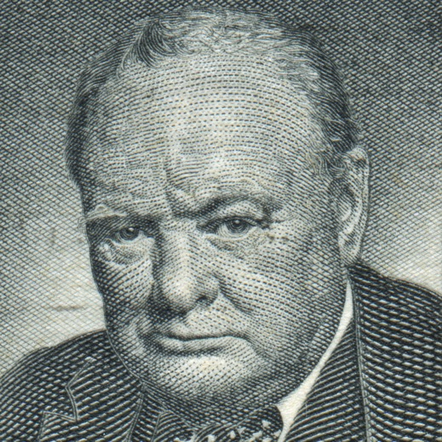
Winston Churchill
Notes:
Sleep scientists also recognize that to truly remain rested and productive we need both a weekly and an annual rest. In Britain during World War I, increased productivity was attempted by continuous, nonstop work schedules. It was later recognized, however, that by reducing the workweek to 48 hours and requiring one day of rest per week, productivity actually increased by 15 percent.
On July 29, 1941, Winston Churchill announced before the House of Commons, “If we are to win this war it will be by staying power. For this reason we must have one holiday per week and one week holiday per year.” That was voted into law!

Slide 22


Weekly and annual rest
Notes:
As humans, we all have our limitations. We cannot work around the clock or without regular times of rest and maintain a healthy, happy, and productive life. We need daily rest as much as we need weekly and annual breaks to provide the mental and emotional recuperation necessary for creativity and positive family relationships. Optimal physical, mental, emotional, and spiritual health require adequate rest.

Slide 23

Rest instituted by God
Notes:
The Bible records that in the very beginning God instituted a weekly rest to provide a much-needed break from the tedium of work. Our Creator knew that in order to function optimally we need balanced daily rest in addition to weekly rest as found in Exodus 20:8-10: “Remember the Sabbath day, to keep it holy. Six days you shall labor and do all your work, but the seventh day is the Sabbath of the Lord your God. In it you shall do no work: you, nor your son, nor your daughter, nor your male servant, nor your female servant, nor your cattle, nor your stranger who is within your gates.”
The Lord wants us to fellowship with Him, especially on the Sabbath day, because He created us as His children. Part of the blessing of the Sabbath rest comes as we support and relate with others during these special hours. Christ said in Mark 2:27, “The Sabbath was made for man, and not man for the Sabbath” (NKJV).
Daily sleep and a weekly rest empower us to be receptive to the blessings of God physically, mentally, emotionally, socially, and spiritually, thus continually restoring us to optimal health.

Slide 24

LIFE APPLICATION QUESTIONS
Notes:
LIFE APPLICATION QUESTIONS

Slide 25

How many times in the last three days have I fallen asleep involuntarily?
Notes:
How many times in the last three days have I fallen asleep involuntarily?

Slide 26

How many hours of nightly sleep have I had during that same time?
Do I need to reassess my sleeping habits?
Notes:
How many hours of nightly sleep have I had during that same time? Do I need to reassess my sleeping habits?

Slide 27

Am I staying up too late at night?
What delays my preparation for bed?
Notes:
Am I staying up too late at night? What delays my preparation for bed?

Slide 28

Do I need to exercise more,
or perhaps earlier in the day?
Notes:
Do I need to exercise more, or perhaps earlier in the day?

Slide 29

Have I had too big a meal
in the evening, or eaten too late?
Notes:
Have I had too big a meal in the evening, or eaten too late?

Slide 30

Am I worrying about something that is keeping me awake?
Notes:
Am I worrying about something that is keeping me awake?

Slide 31

Am I choosing to watch too much TV or play too many games?
Notes:
Am I choosing to watch too much TV or play too many games?

Slide 32
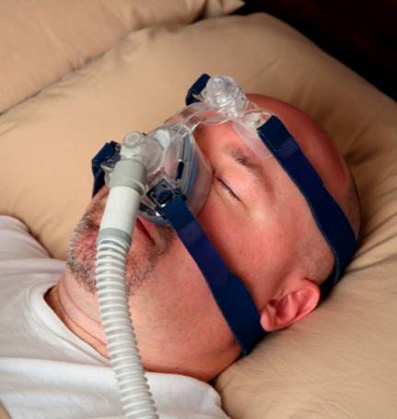
Do I need to see my physician about a sleep disorder, such as sleep apnea?
Notes:
Do I need to see my physician about a sleep disorder, such as sleep apnea?

Slide 33

A husband and wife worked late and then went out to dinner with friends. The meal was delicious, but the couple ate too much.
Notes:
A husband and wife worked late and then went out to dinner with friends. The meal was delicious, but the couple ate too much.

Slide 34

Neither slept well when they eventually got to bed. The next evening they arrived home late again and then watched a late-night TV show.
Notes:
Neither slept well when they eventually got to bed. The next evening they arrived home late again and then watched a late-night TV show.

Slide 35

The next morning the couple had a heated argument about who should fetch the dry cleaning. Why would they argue about such an inconsequential thing?
Notes:
The next morning the couple had a heated argument about who should fetch the dry cleaning. Why would they argue about such an inconsequential thing?

Slide 36

Were they thinking clearly? How can I prevent something like that from happening to me?
Notes:
Were they thinking clearly? How can I prevent something like that from happening to me?

Slide 37

How many of the following symptoms have I observed in myself lately?
lower productivity
short attention span
Notes:
How many of the following symptoms have I observed in myself lately?
lower productivity;
short attention span;

Slide 38

inability to solve complex problems, think clearly, or remember quickly
Notes:
inability to solve complex problems, think clearly, or remember quickly.

Slide 39

How do I demonstrate that I value my sleep?
What choices do I have to make in order to get adequate and restful sleep?
Notes:
How do I demonstrate that I value my sleep?
What choices do I have to make in order to get adequate and restful sleep?

Slide 40

Should I choose to get up at the same time on weekends as I do during the week so that I establish good-habit patterns?
Notes:
Should I choose to get up at the same time on weekends as I do during the week so that I establish good-habit patterns?

Slide 41

What arrangements in my bedroom do I have to change to foster better sleep?
Notes:
What arrangements in my bedroom do I have to change to foster better sleep?

Slide 42
What arrangements in my bedroom do I have to change to foster better sleep?
How can I make a decided choice to put my trust in God and leave my burdens with Him?
Notes:
How can I make a decided choice to put my trust in God and leave my burdens with Him?

Slide 43

In what ways do I show that I value the rest that the Sabbath offers?
Notes:
In what ways do I show that I value the rest that the Sabbath offers?

Slide 44
In what ways do I show that I value the rest that the Sabbath offers?
Do I use the Sabbath hours to catch up on my sleep debt from a week of bad choices?
Notes:
Do I use the Sabbath hours to catch up on my sleep debt from a week of bad choices?

Slide 45

Or do I enjoy the same type of rest that God took after Creation—
Notes:
Or do I enjoy the same type of rest that God took after Creation—

Slide 46
Or do I enjoy the same type of rest that God took after Creation—
a rest from work in order to spend time in growing my relationships with God, family, and community?
Notes:
—a rest from work in order to spend time in growing my relationships with God, family, and community?

Slide 47

Do I use the full vacation time allotted to me?
Notes:
Do I use the full vacation time allotted to me?

Slide 48

How can I best use this time in a balanced way to adequately rejuvenate physically, mentally, emotionally, and spiritually?
Notes:
How can I best use this time in a balanced way to adequately rejuvenate physically, mentally, emotionally, and spiritually?

Slide 49

How can I plan more purposefully to gain the benefits I need to offset the stresses and deficiencies I experience during the rest of the year?
Notes:
How can I plan more purposefully to gain the benefits I need to offset the stresses and deficiencies I experience during the rest of the year?

